Slide 1
Lesson 4
Embedded Systems

Slide 2
Why do some meteor showers happen at the same time every year?
Why do we see more meteors between midnight and early morning?
Notes:
We see more meteors between midnight and dawn because, like driving through a snowfall, the Earth rotates into the leading edge of its orbit, facing more space debris head-on after midnight, increasing the frequency and speed of impacts, similar to windshield wipers catching more snowflakes when the car moves forward. The Earth's rotation brings observers from the "rear" of the planet's path (evening) to the "front" (morning), allowing more direct collisions with meteoroid streams, making them brighter and more numerous before sunrise washes them out.

Slide 3
How to Breadboard…
ASD or OCD
Making Art with Circuits

Slide 4
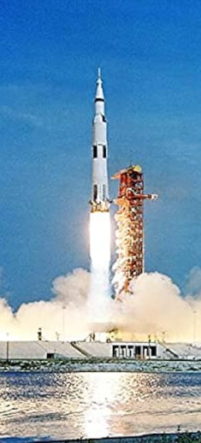
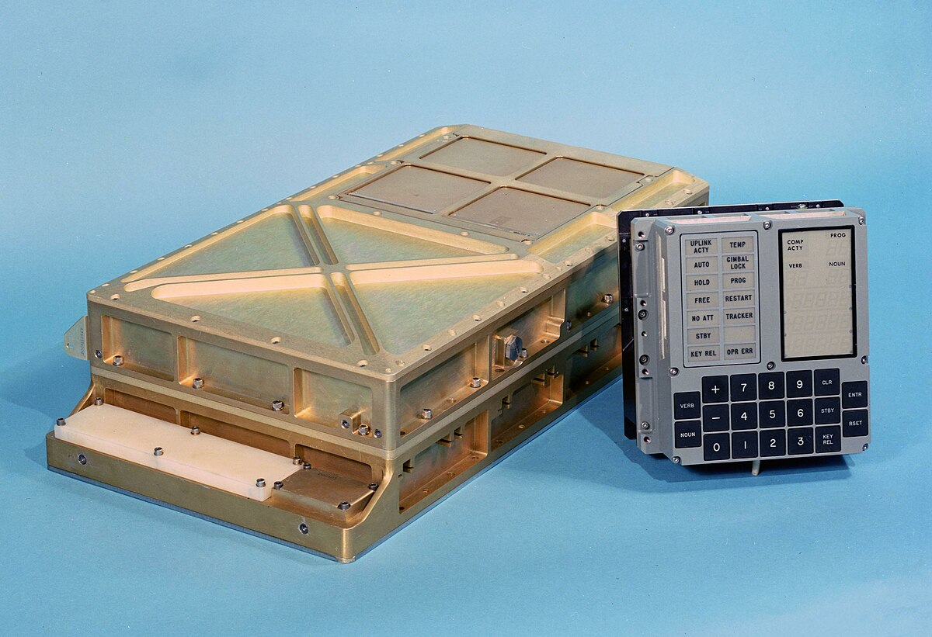
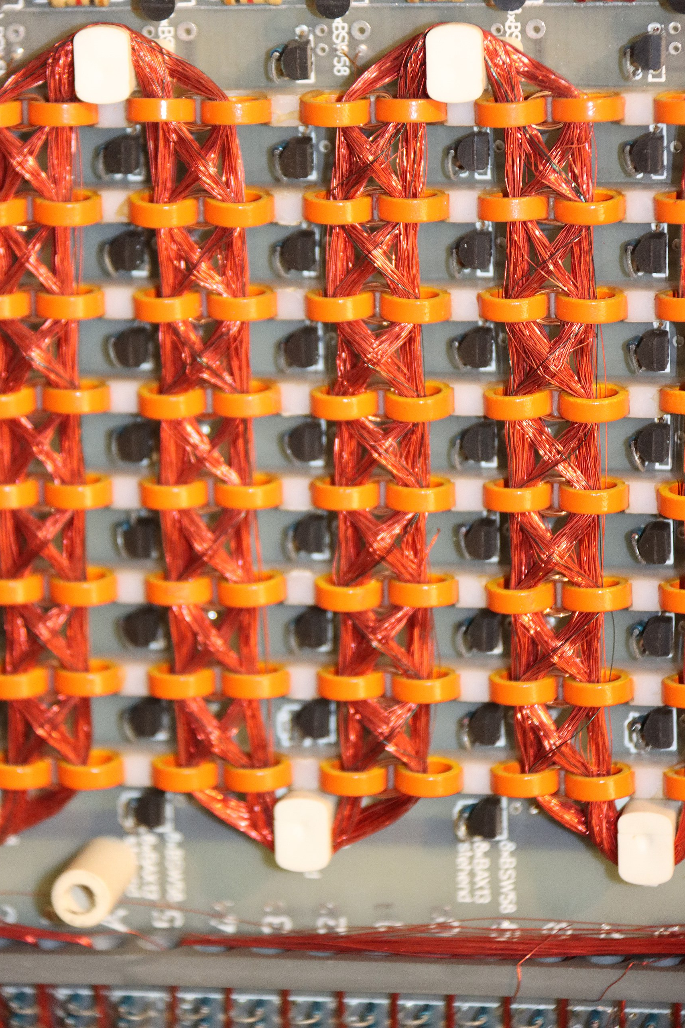
What is this?
Apollo Guidance Computer
CPU word size: 15-bit (plus parity)
Clock speed: ~1.024 MHz
Instruction rate: ~85,000 instr/sec
RAM: ~2 KB (erasable core memory)
ROM: ~36 KB (core rope memory)
Mass: ~32 kg
Power: ~55 W
Modern Smartphone (~2024)
CPU word size: 64-bit
Clock speed: 2–3.5 GHz (multiple cores)
Instruction rate: ~10¹¹–10¹² instr/sec RAM: 8–16 GB
Storage: 128 GB–1 TB flash
Mass: ~200 g
Power: ~2–6 W (active SoC)
AGC Core Rope Memory
Notes:
The Apollo Guidance Computer (AGC) was the primary onboard flight computer for the Apollo spacecraft, used in both the Command Module (CM) and Lunar Module (LM). It was responsible for:
Navigation state estimation
Guidance law execution
Attitude control commands
Crew interface and monitoring
Fault detection and recovery
It was the first digital computer used for real-time crewed spaceflight control and one of the earliest embedded real-time systems ever deployed.
The Apollo Guidance Computer was a purpose-built real-time embedded system
It used minimal hardware to achieve maximum mission assurance
Its architecture emphasized determinism, reliability, and human integration
Many of its design principles remain best practice for spacecraft avionics today
Core rope memory was the primary read-only memory (ROM) technology used by the Apollo Guidance Computer to store its flight software. It represents one of the most physically literal implementations of software ever flown: programs were woven into hardware.
Core rope memory stores data using magnetic cores (tiny ferrite rings) threaded by wires:
Wire passing through a core → represents a binary 1
Wire bypassing a core → represents a binary 0
The pattern of wire routing is the program. Once manufactured, the contents cannot be changed without physically rewiring the module.
This differs from core RAM (used elsewhere in the AGC), where current direction magnetizes cores dynamically. Core rope memory is passive, non-volatile, and immutable.
Core rope memory was selected because it was:
Radiation-hard – immune to SEUs and ionizing radiation
Non-volatile – retained data with no power
Extremely reliable – no moving parts, no refresh
High density (for the era) – much denser than flip-flop or diode ROM
Deterministic – no corruption, no bit drift
For a crewed lunar mission in the 1960s, these attributes mattered more than flexibility.
How It Was Made (“Weaving Software”)
Software engineers finalized the program in assembly language.
Memory specialists translated the binary into wiring patterns.
Skilled technicians (many were textile workers) hand-wove the wires through or around each core.
Errors required manual rework, cutting and rethreading wires.
This process earned the nickname “LOL memory” — Little Old Ladies memory — a reflection of who performed the meticulous weaving, not an official term.

Slide 5
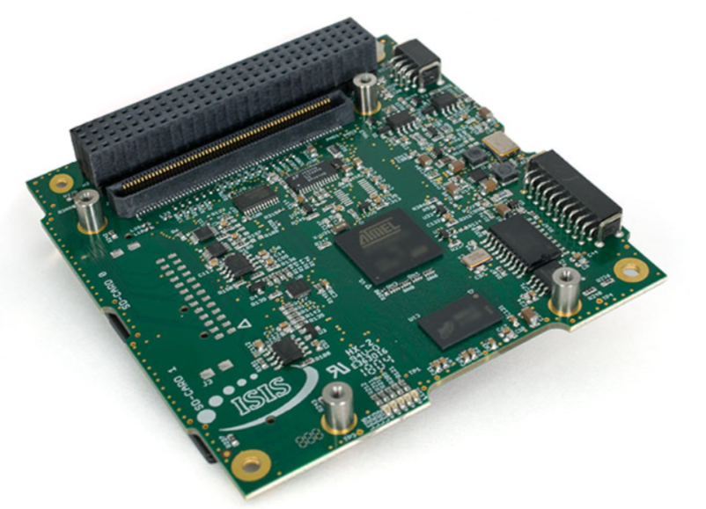
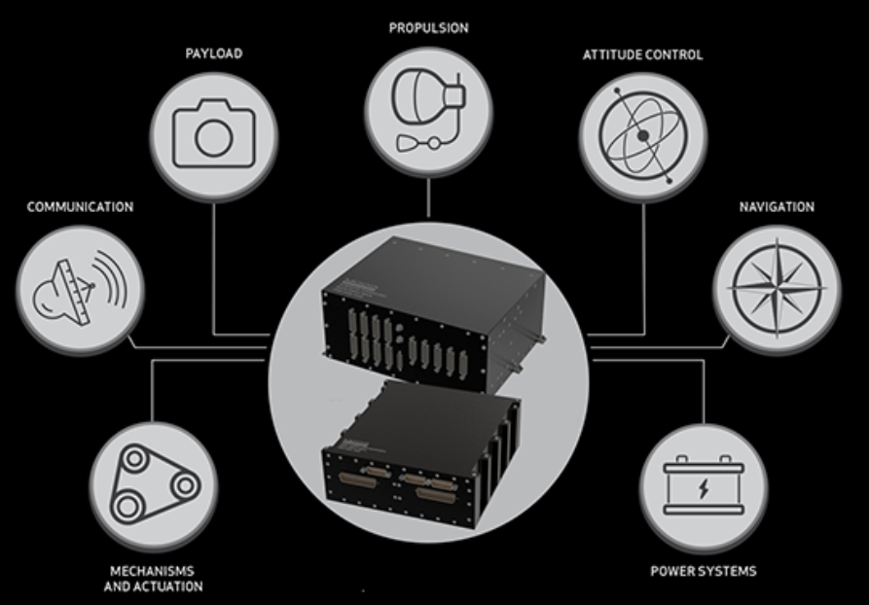
Embedded Systems Overview
Embedded system: a dedicated computing system designed to perform specific, deterministic functions within a larger system, subject to tight constraints on power, timing, mass, and reliability.
→ The “nervous system” of a spacecraft—manages commands, data, and coordination between subsystems.
COTS CubeSat
Computer
Spacecraft Embedded Systems
Characteristics:
Dedicated function (not general-purpose)
Deterministic timing behavior
Tight hardware–software coupling
Long operational lifetime
Often safety- or mission-critical
Challenges:
No physical access after deployment
Severe power and mass limits
Harsh radiation and thermal environments
Hard real-time control requirements
Mission-critical reliability expectations

Slide 6
Computer Components
CPU – Central Processing Unit
Where processing occurs
Electronic circuitry that executes instructions, including performing basic arithmetic, logic, controlling, and input/output (I/O) operations
I/O – input/output devices (AKA GPIO – General Purpose Input/Output)
Allows computer to communicate with other devices
RAM – Random access memory
Volatile storage: memory that only retains information while computer is powered
Fast: memory device that allows data items to be read or written in almost the same amount of time irrespective of the physical location of data inside the memory
Used to record and store data quickly
PROM – Programmable read-only memory
Non-volatile storage: memory that retains information when not powered
Permanent: Form of digital memory where the contents can be changed once after manufacture of the device, but once written, the data is then permanent and cannot be changed
Used to store spacecraft software “image” which is like an operating system, which ideally is not changed during the mission
Flash memory
Non-volatile memory storage that can be electrically erased and reprogrammed
Fast read-access time, mechanically shock-resistant
Can endure only a relatively small number of write cycles for a single block

Slide 7
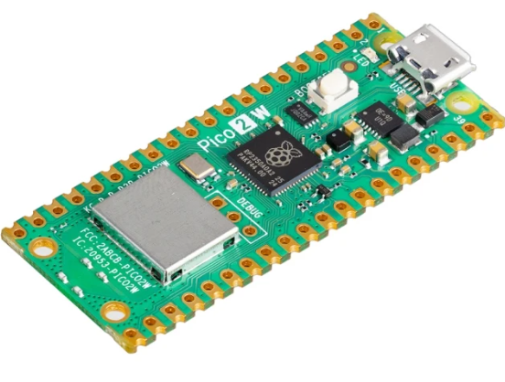
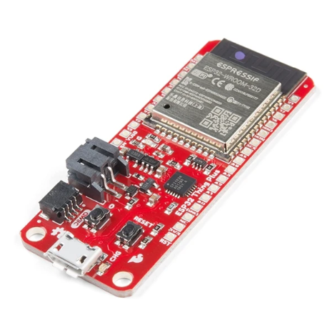
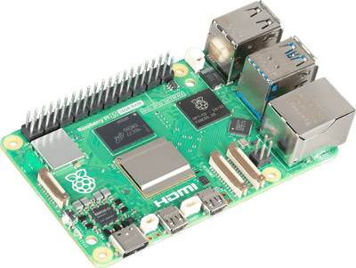
Types of computers
Microcontroller (MCU)
A single-chip computer that integrates a processor, memory, and peripherals for control-oriented tasks.
No or very rudimentary operating system
Designed for embedded control of devices, e.g. controlling a reaction wheel motor or reading sensor data.
Includes processor core + RAM + Flash + I/O interfaces.
Example: Arduino Uno, Raspberry Pi Pico
Microprocessor (MPU)
Computer optimized for high-level processing and flexibility, not necessarily direct hardware control.
Has operating system (Windows, Linux, etc.)
Example: Onboard computer for payload data processing (e.g., image analysis

Slide 8
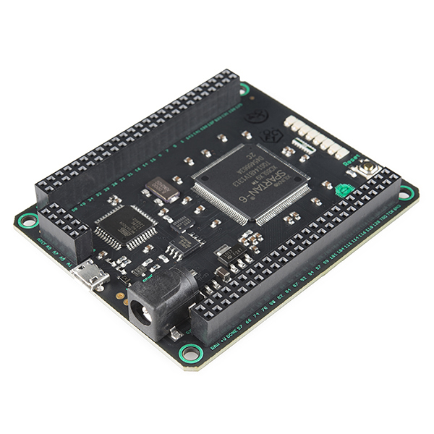
FPGA’s
Field-Programmable Gate Array (FPGA)
An integrated circuit that can be configured after manufacturing to implement custom digital logic circuits.
Key trait: Hardware reconfigurability—can perform massively parallel tasks.
Example: Real-time high-speed signal processing for radar or communications.
Contains: Arrays of configurable logic blocks (CLBs), programmable interconnects, and sometimes embedded processors.

Slide 9
Comparison of MCU’s and MPU’s
Feature / Device | Microcontroller (MCU) | Microprocessor (MPU)
Description | Single-chip computer with CPU, memory, and peripherals integrated. | General-purpose CPU chip; needs external memory & peripherals.
Main Role | Device control, simple data processing, direct hardware interfacing. | Complex computations, operating systems, data processing.
Integration | CPU + RAM + Flash + I/O all on-chip. | CPU only; memory & I/O are external.
Performance | Moderate speed, optimized for low power. | High performance for sequential tasks.
Flexibility | Fixed hardware & peripherals. | Flexible software, fixed hardware.
Spacecraft Example | Reading sensors, controlling motors. | Onboard computer for image compression.
Radiation Tolerance | Available in rad-tolerant versions. | Available in rad-tolerant versions.
Power Consumption | Low. | Medium to high.

Slide 10
Example Embedded Systems Architecture
Memory – Nonvolatile (flash)
Memory – Volatile (RAM)
Comm – Xbee Transceiver
MCU
Power
Actuator – Reaction Wheel Motor Driver
Sensor – Sun Sensor
Sensor - IMU
Sensor – Voltage/current

Slide 11
Software Architecture & Timing
Execution Models
Super-loop
Interrupt-driven
RTOS-based (tasks, priorities, semaphores)
Real-Time Considerations
Hard vs soft deadlines
Sensor sampling jitter
Control loop timing
Interrupt latency
Failure Modes
Priority inversion
Watchdog resets
Stack overflows
Race conditions
Spacecraft necessities
Watchdogs are mandatory
Safe-mode code paths
Deterministic boot behavior
Notes:
Execution Models
Super-Loop (Cyclic Executive)
A super-loop is the simplest embedded software architecture: the processor executes an infinite loop that sequentially calls each function (e.g., read sensors → compute control → send telemetry → check faults).
Why it exists
Extremely predictable
Easy to analyze and test
Minimal overhead (no scheduler)
Space relevance
Used in early spacecraft, sounding rockets, simple CubeSats
Still viable when:
Task timing is slow and regular
Few asynchronous events exist
Control laws are simple
Limitations
Poor scalability as system complexity grows
Long execution of one task delays all others
Difficult to handle asynchronous events (e.g., radio interrupts)
Interrupt-Driven Architecture
Here, the CPU executes a main loop, but interrupts preempt execution when hardware events occur (timers, sensors, radios).
Common interrupt sources
IMU data ready
Radio packet received
Timer tick
Fault signals
Advantages
Fast response to real-world events
Efficient CPU usage
Enables precise timing (e.g., sensor sampling)
Risks
Interrupt storms
Priority conflicts
Hard-to-debug race conditions
Stack corruption if poorly managed
Space relevance
Essential for:
Control loops
High-rate sensors
Communication links
→ Interrupts give responsiveness, but discipline is required — every interrupt must be short, bounded, and justified.
RTOS-Based Architecture
A Real-Time Operating System schedules multiple tasks according to priority and timing constraints.
Key RTOS concepts
Tasks/threads
Priorities
Semaphores and mutexes
Message queues
Timers
Why spacecraft use RTOS
Clean separation of functions (ADCS, comms, payload)
Easier scaling to complex missions
Explicit timing guarantees
Tradeoffs
Increased software complexity
Scheduler overhead
New failure modes (priority inversion, deadlock)
Space relevance
Common on modern CubeSats and small satellites
Often used with:
Deterministic kernels
Static task allocation
Conservative scheduling
-----------------------------------------------------------
Real-Time Considerations
Hard vs soft deadlines
Hard real-time
Missing a deadline is a system failure
Example: reaction wheel control update
Soft real-time
Performance degrades, but system survives
Example: delayed telemetry packet
Why this matters
Drives architecture decisions
Determines which tasks get highest priority
Influences processor selection
Sensor Sampling Jitter
Jitter is variation in the timing of sensor reads.
Why it matters
Control laws assume fixed sample periods
Variable timing introduces noise and instability
Sources of jitter
Interrupt interference
Task preemption
Poor scheduler design
Mitigation strategies
Timer-driven sampling
High-priority sensor tasks
DMA where possible
Control Loop Timing
Control algorithms assume:
Fixed update rates
Known latency between sensing and actuation
Violations cause
Phase lag
Reduced stability margins
Oscillations or divergence
Spacecraft implication
Software timing errors can destabilize a physically stable vehicle
Interrupt Latency
Interrupt latency is the delay between a hardware event and the start of its handler.
Why it matters
Late control updates
Missed communication windows
Loss of synchronization
Sources
Disabled interrupts
Long ISRs
RTOS critical sections
-----------------------------------------------------------
Failure Modes
Priority Inversion
Occurs when:
A low-priority task holds a resource
A high-priority task waits for it
A medium-priority task preempts both
Impact
High-priority task misses deadline
System behaves unpredictably
Mitigation
Priority inheritance
Careful resource design
Watchdog Resets
Watchdogs reset the processor if software becomes unresponsive.
Common causes
Infinite loops
Deadlocks
Memory corruption
Space practice
Watchdog is mandatory
Reset paths must be deterministic
Post-reset behavior must be safe
Stack Overflows
Embedded systems use limited stack memory.
Causes
Deep recursion
Large local variables
Too many RTOS tasks
Consequences
Silent memory corruption
Random crashes
Extremely difficult debugging
Race Conditions
Occurs when:
Multiple tasks access shared data
Execution order is nondeterministic
Space impact
Rare, unreproducible failures
Often appear late in mission
-----------------------------------------------------------
Space-Specific Practice
Mandatory Watchdogs
Hardware watchdogs preferred
Software watchdogs as secondary layer
Must reset on real progress, not loops
Safe-Mode Code Paths
Safe mode is a minimal, survivable configuration.
Characteristics
Reduced functionality
Guaranteed power positivity
Minimal code paths
Deterministic Boot Behavior
After reset:
System must reach known state
Critical subsystems initialized first
No dependency on prior memory state

Slide 12
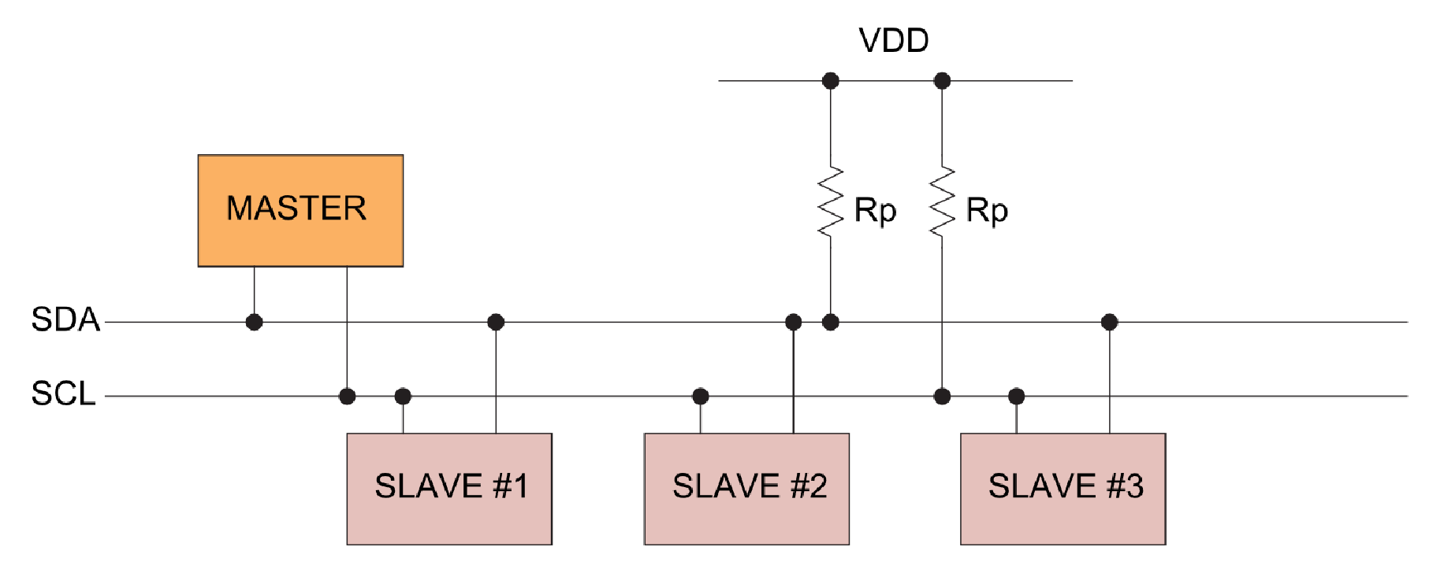
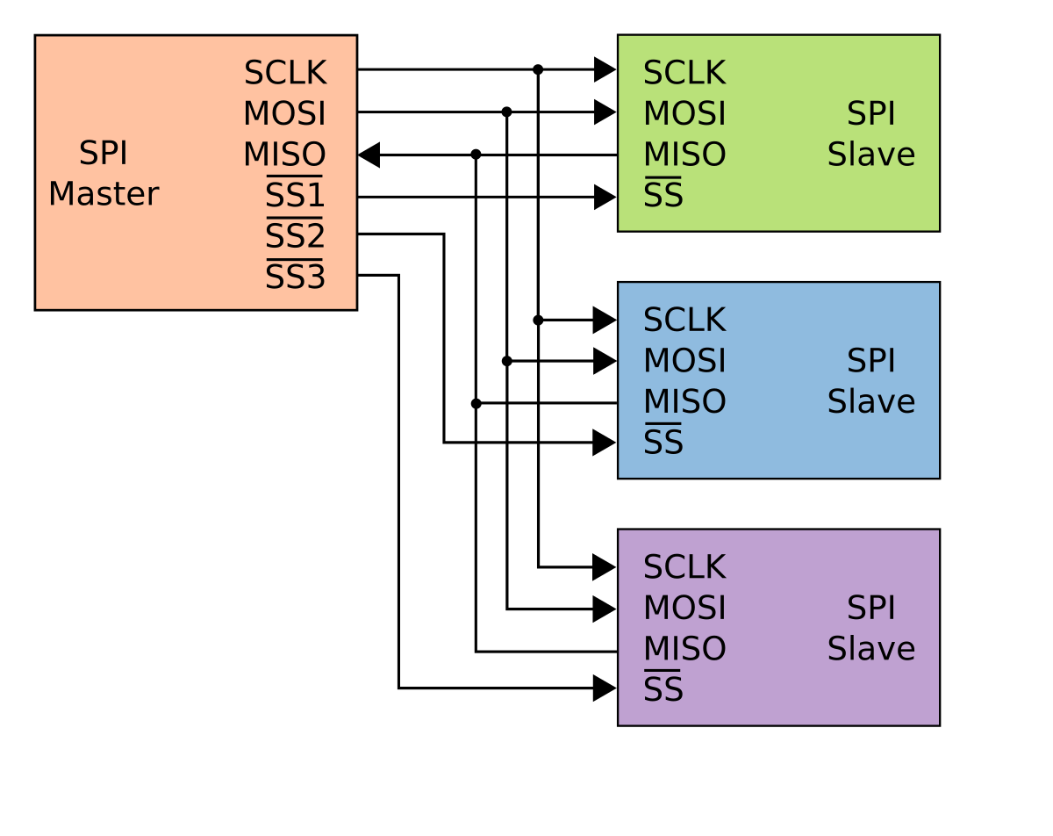
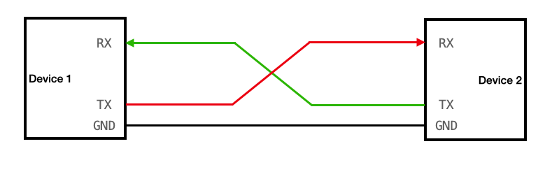
Connecting to Peripherals
Communication Protocols
I²C: two-wire serial protocol for short-distance communication between multiple devices using addresses.
SPI: high-speed serial protocol using separate lines for data in, data out, clock, and chip select.
UART: simple asynchronous serial communication protocol that sends data one bit at a time over TX/RX lines.
CAN: robust multi-master serial bus used in automotive and industrial systems for message-based communication.
Microcontroller
I²C
Sensors/devices
Sensors/devices
Microcontroller
SPI
**ALWAYS CONNECT GROUNDS BETWEEN DEVICES**
UART
Notes:
UART (Universal Asynchronous Receiver/Transmitter)
Serial Peripheral Interface (SPI)
Controller Area Network (CAN)

Slide 13
Space Environment Effects
Radiation Effects
Total Ionizing Dose (TID): Gradual accumulation of radiation can change transistor thresholds and increase leakage currents, eventually causing permanent malfunction.
Single Event Effects (SEE): High-energy particles can flip bits in memory (Single Event Upsets, SEU), trigger transient faults (Single Event Transients, SET), or even cause destructive latch-up (Single Event Latch-up, SEL).
Temperature Extremes
Space systems experience wide temperature swings, which can affect clock stability, logic levels, and semiconductor reliability.
Vacuum Effects
Outgassing of materials in vacuum can contaminate sensitive electronics, and the lack of convection changes cooling dynamics.
Electromagnetic Interference (EMI)
Spacecraft electronics must tolerate interference from solar activity, onboard switching circuits, and communications systems.
Mechanical Stress
Vibrations during launch and micro-meteoroid impacts can damage delicate solder joints, PCBs, and connectors, indirectly affecting digital system integrity.

Slide 14
Radiation hardening
Rad-Hard: Expensive, proven, but lower performance.
COTS: Cheaper, faster, but require techniques like redundancy (using multiple chips) or error-correcting memory to be reliable.
Notes:
Why Radiation Matters
Spacecraft electronics operate outside Earth’s atmospheric and magnetic shielding
Ionizing radiation alters electronic behavior, even when no physical damage is visible
Most space anomalies trace back to radiation-induced faults, not mechanical failure
Primary Radiation Effects on Embedded Systems
Single-Event Effects (SEE)
Caused by a single high-energy particle strike
Includes:
SEU (bit flip in memory or registers)
SEL (latch-up → destructive overcurrent)
SEFI (functional interrupt requiring reset)
Total Ionizing Dose (TID)
Long-term charge accumulation in materials
Gradual degradation of:
Transistor thresholds
Leakage currents
Timing margins
Displacement Damage
Crystal lattice damage in semiconductors
Primarily affects sensors and analog components
Hardware-Level Hardening Approaches
Rad-Hard Components
Designed and fabricated for radiation tolerance
Advantages:
Predictable behavior
Minimal mitigation required
Disadvantages:
Very high cost
Low performance
Limited availability
Rad-Tolerant Components
Screened or characterized COTS parts
Balance between cost and reliability
Key Reality
Radiation tolerance is rarely a single part decision — it is a system architecture decision
Software & System-Level Mitigation (Most Common in Small Satellites)
Memory Protection
ECC / parity memory
Periodic memory scrubbing
Fault Tolerance
Watchdog timers
Automatic reboot capability
Known-safe boot states
Redundancy
Cold or warm redundant processors
Task-level redundancy
Voting schemes (where justified)
Design Philosophy
Assume faults will occur
Focus on detection, isolation, and recovery, not prevention alone
Embedded Design Tradeoff (Key Slide Message)
Radiation hardening trades performance and cost for predictability and survivability.
Large spacecraft: favor rad-hard hardware
CubeSats & small missions: favor COTS + mitigation
Mission success depends more on fault recovery than raw tolerance
Takeaway for Space Systems Engineers
Radiation is not just an electrical problem — it is a software, power, and systems engineering problem
The question is not “Will radiation affect my system?”
It is “How will my system behave when it does?”

Slide 15
Embedded Systems Hardware Design

Slide 16
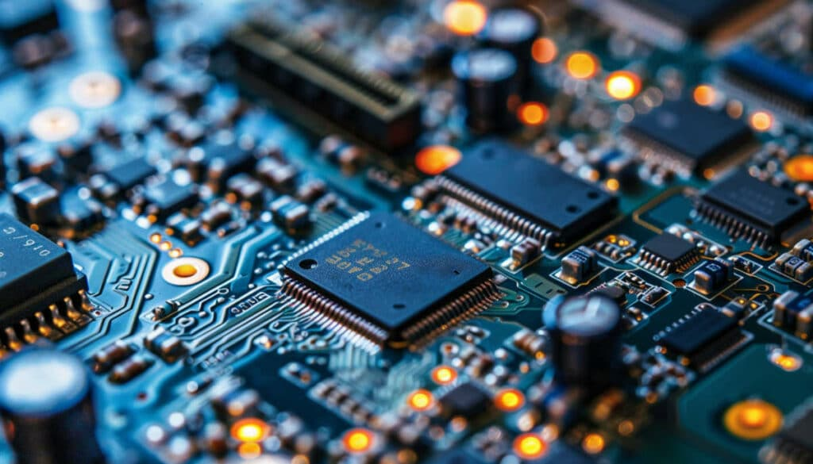
Embedded Systems Hardware
Like other computer systems, embedded systems contain electronic hardware that house and connect individual components.
→Embedded systems hardware for spacecraft must be well designed and tested in order to meet strict performance & resiliency requirements.

Slide 17
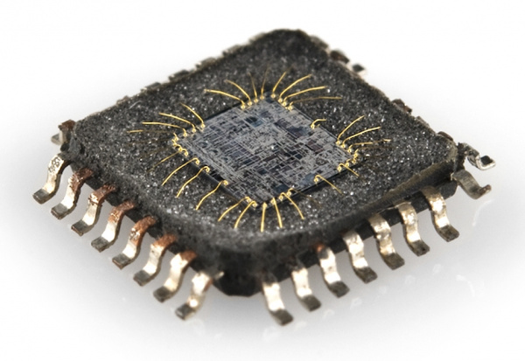
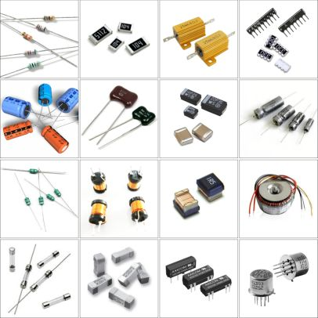
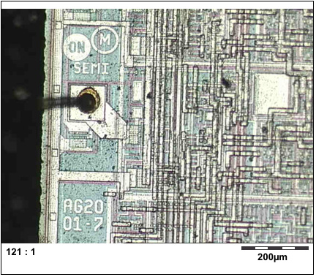
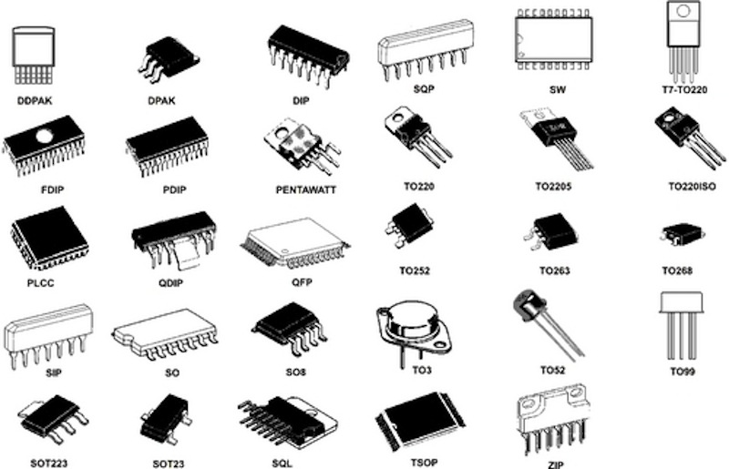
Common Embedded System Components
Discrete components
Resistors
Capacitors
Inductors
Diodes
Transistors
Switches
Relays
Connectors
Fuses
Integrated Circuits (IC)
MCU’s
Microelectromechanical (MEMS) sensors
Flash memory
RAM
Voltage regulators
Transceivers
ADCs
Inside of an IC
Notes:
An Integrated Circuit (IC) is a tiny electronic circuit built onto a small piece of semiconductor material (usually silicon) that contains a combination of components such as transistors, resistors, capacitors, and diodes, all interconnected to perform a specific function.
https://learn.sparkfun.com/tutorials/integrated-circuits/all

Slide 18
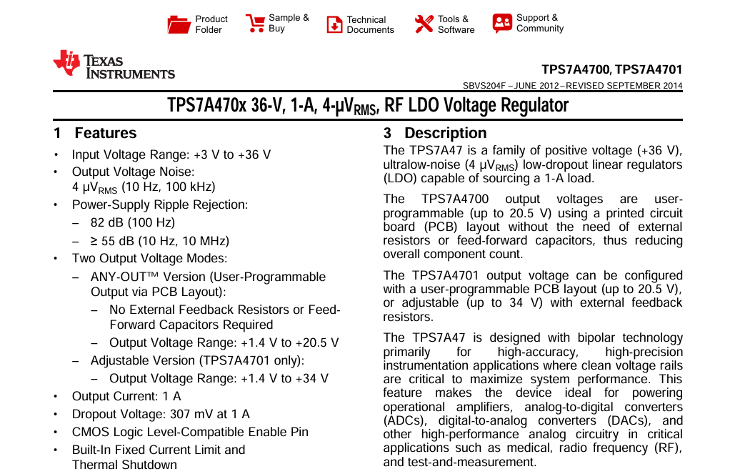
Component Datasheets
A manufacturer’s technical document describing the characteristics, limits, and usage of an electronic component.
Absolute Maximum Ratings – Don’t exceed these values (voltage, current, temp).
Electrical Characteristics – Nominal operating conditions (e.g., Vcc, I/O levels, power consumption).
Pinout / Pin Functions – What each pin does.
Block Diagram / Functional Description – Internal overview of how it works.
Timing Diagrams – For digital ICs: setup/hold times, clocking.
Application Circuits – Example schematics and recommended usage.
Package Information – Dimensions, footprint for PCB layout.

Slide 19
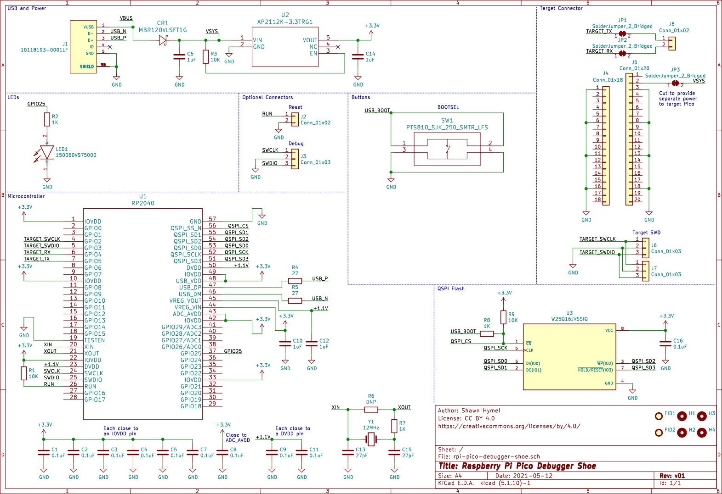
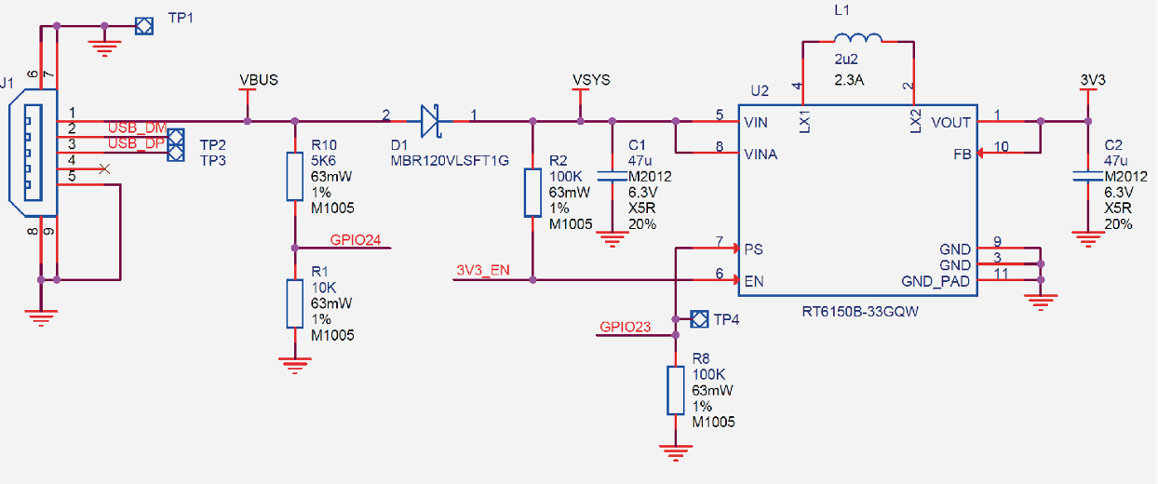
Schematic Design
A diagram that represents the circuit in symbolic form.
Each electronic component (resistor, capacitor, IC, connector, etc.) is drawn using a standardized symbol, and the connections (nets) show how signals and power flow between them.
Powerchain of the Raspberry Pi Pico

Slide 20
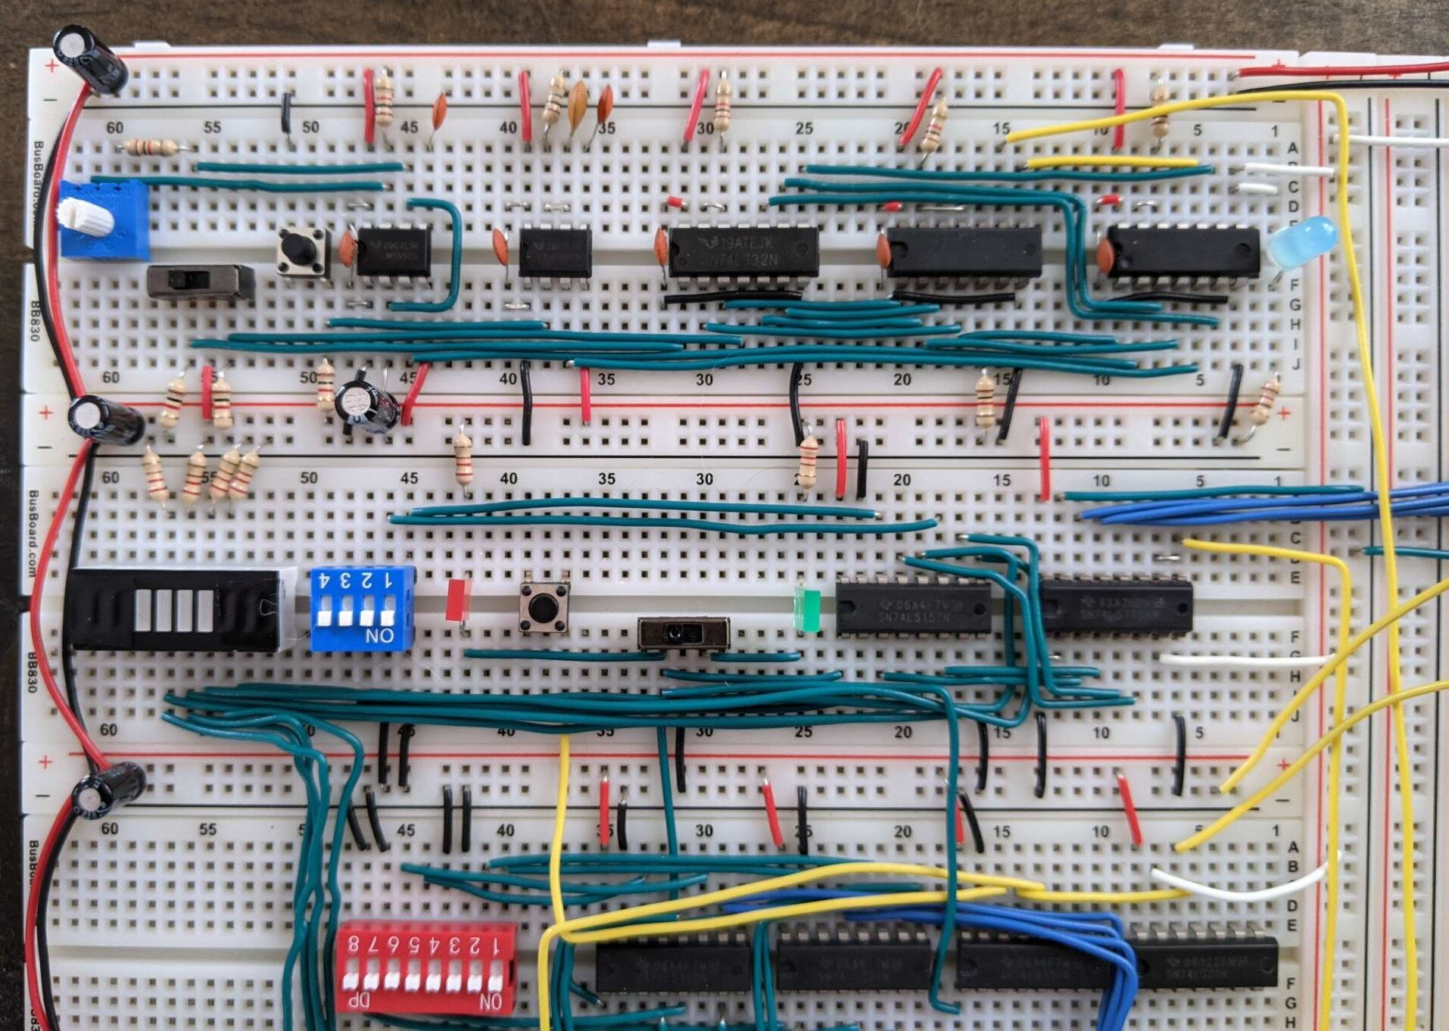
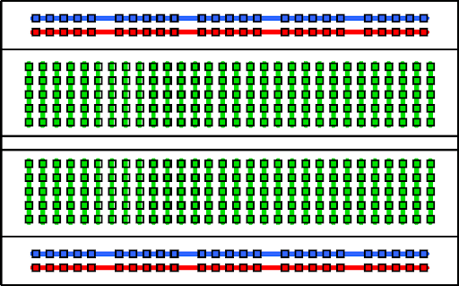
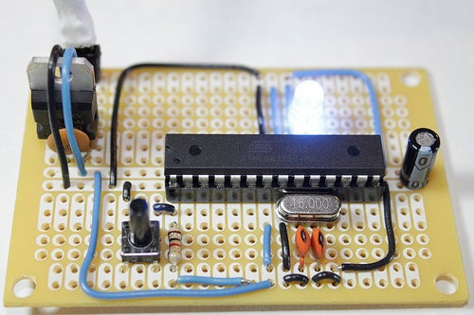
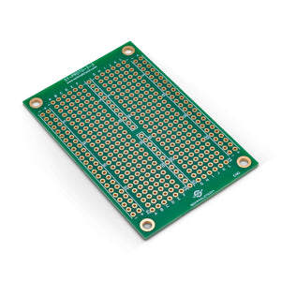
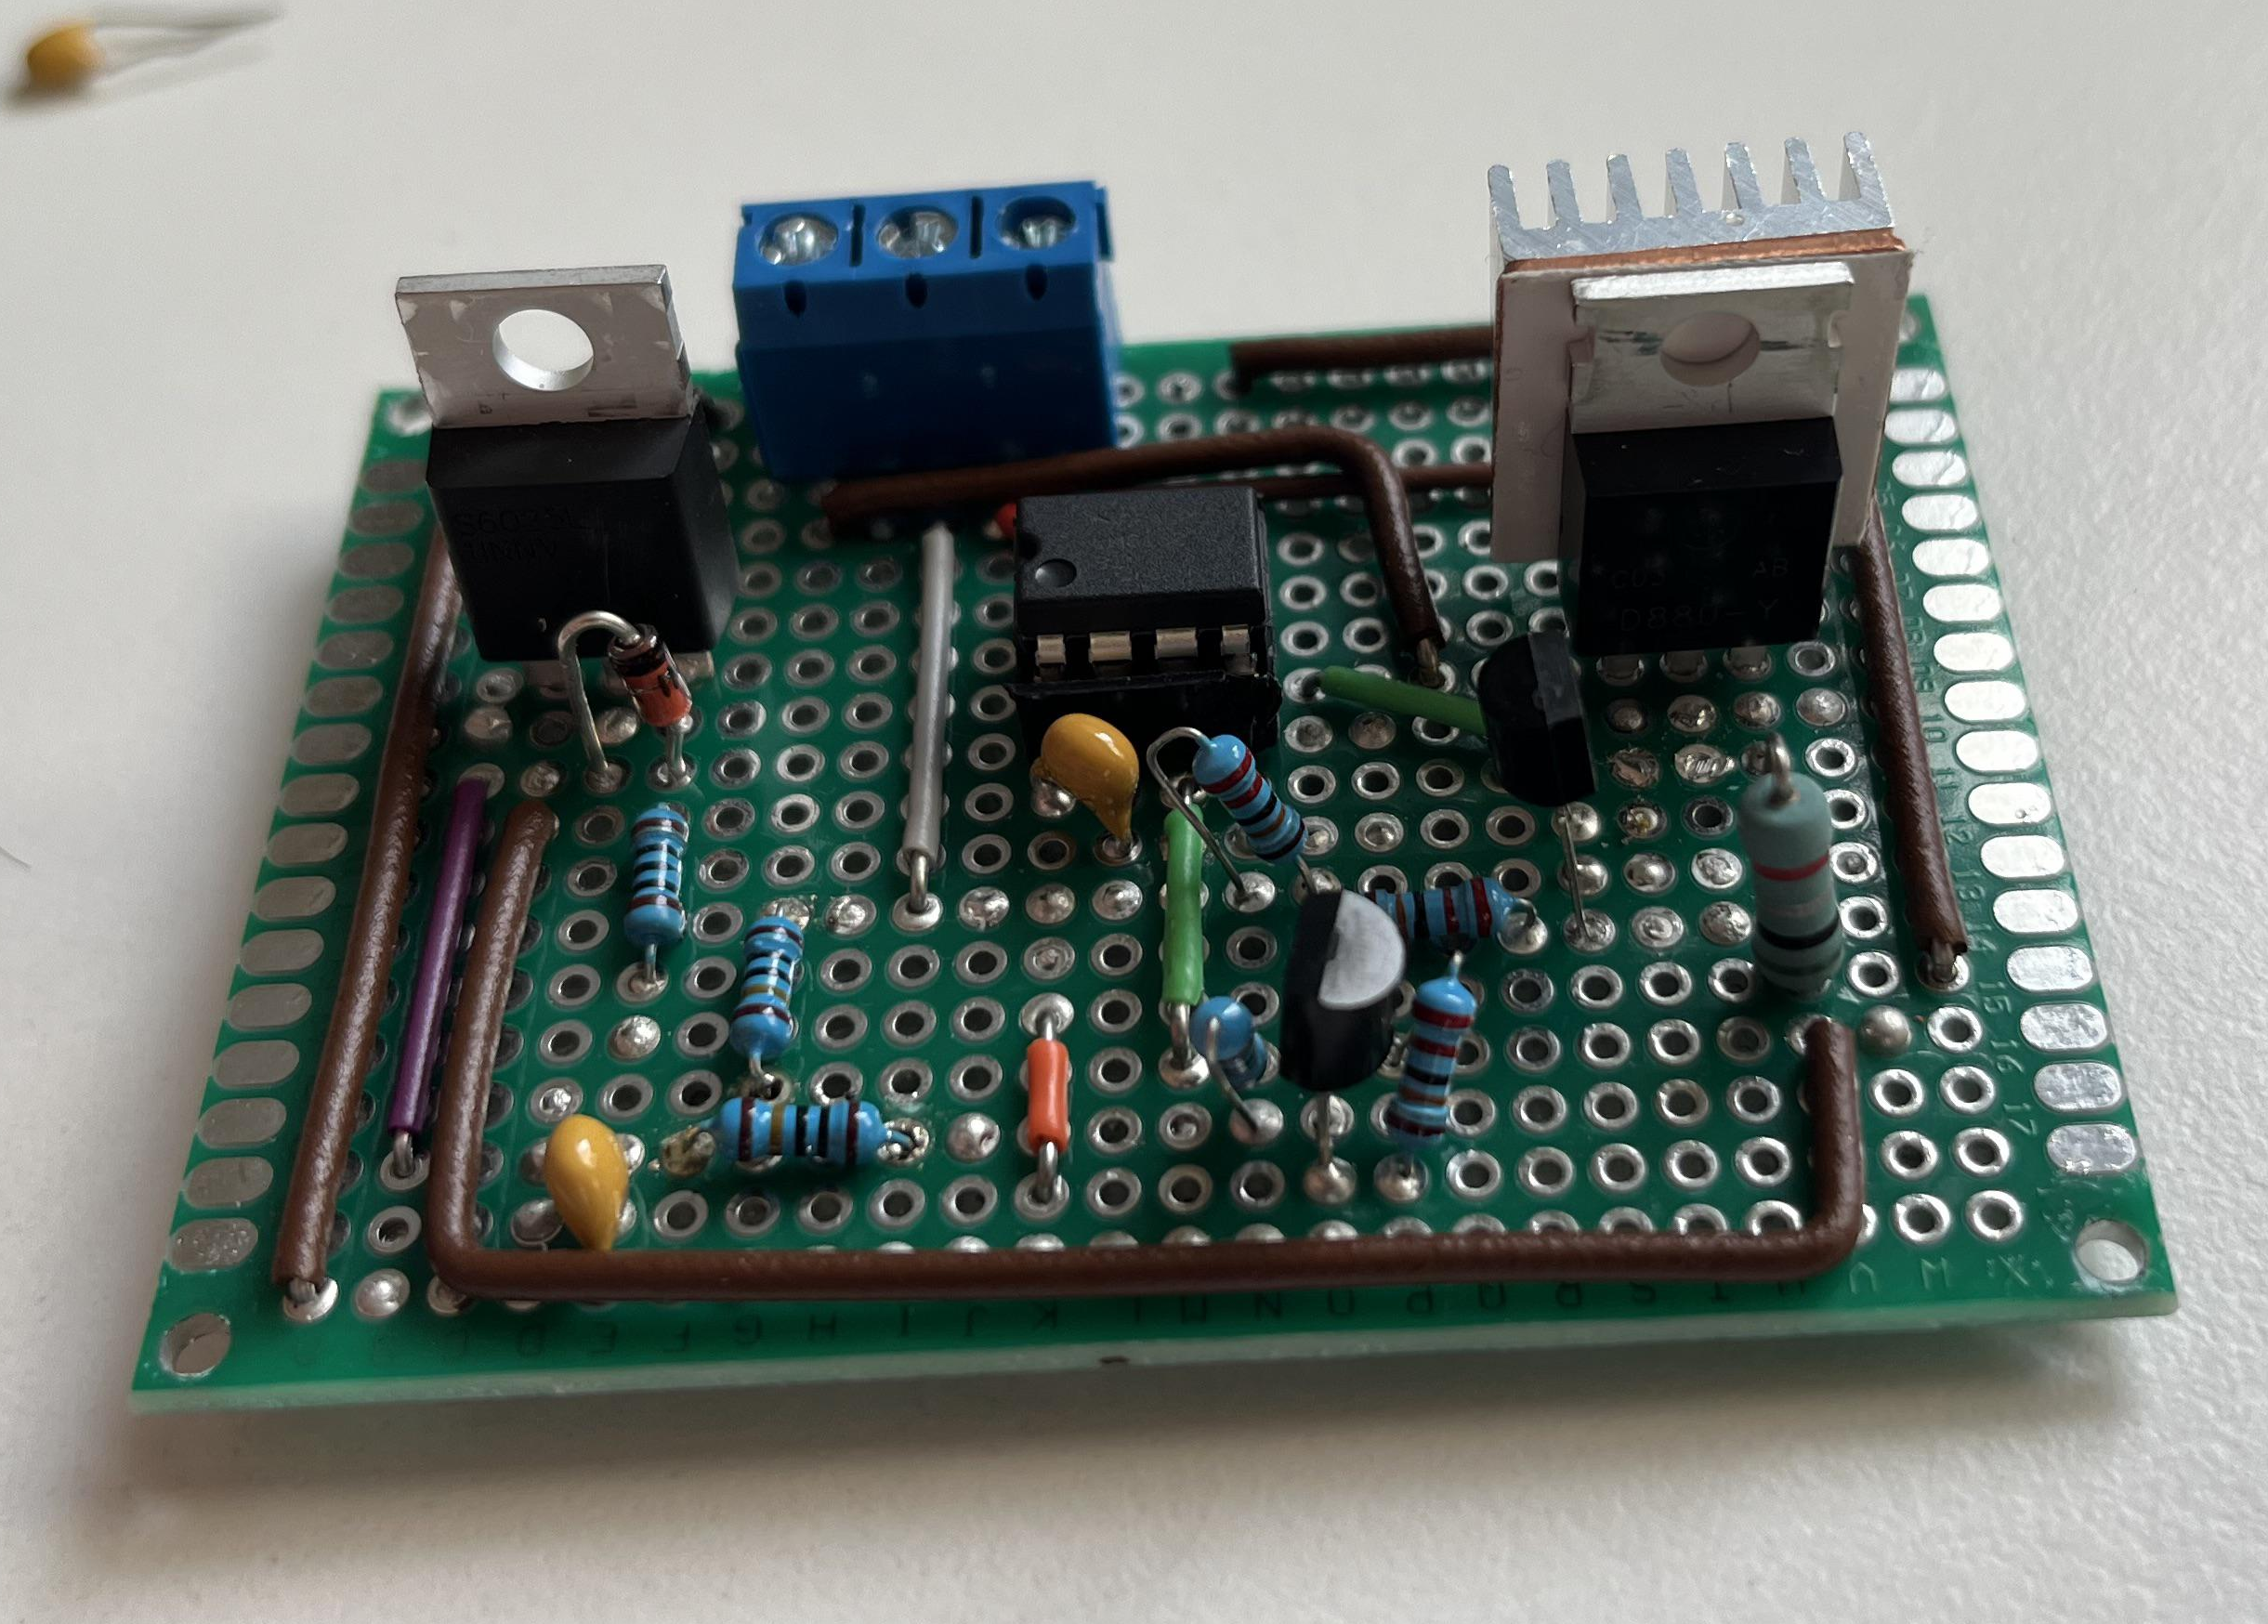
Prototyping Electronic Systems
How do we connect electronic components into systems?
Prototyping:
Breadboarding
Perfboard/protoboard

Slide 21
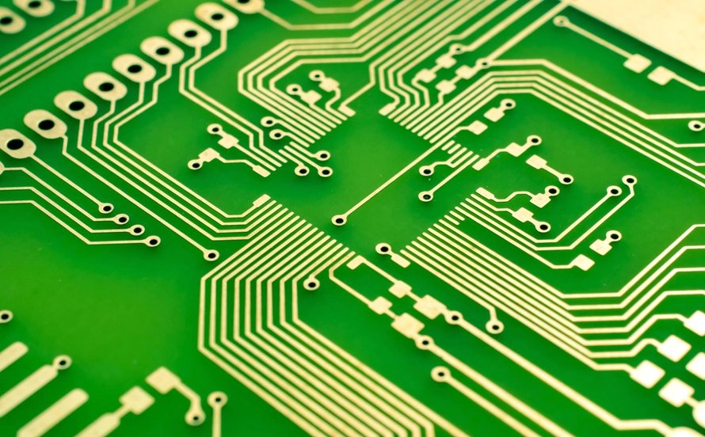
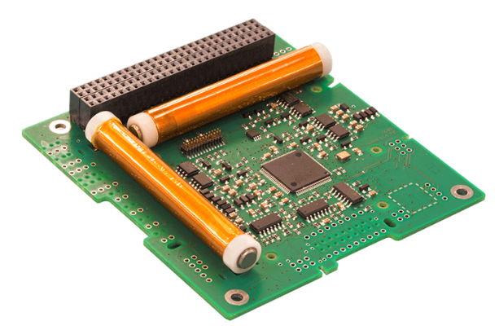
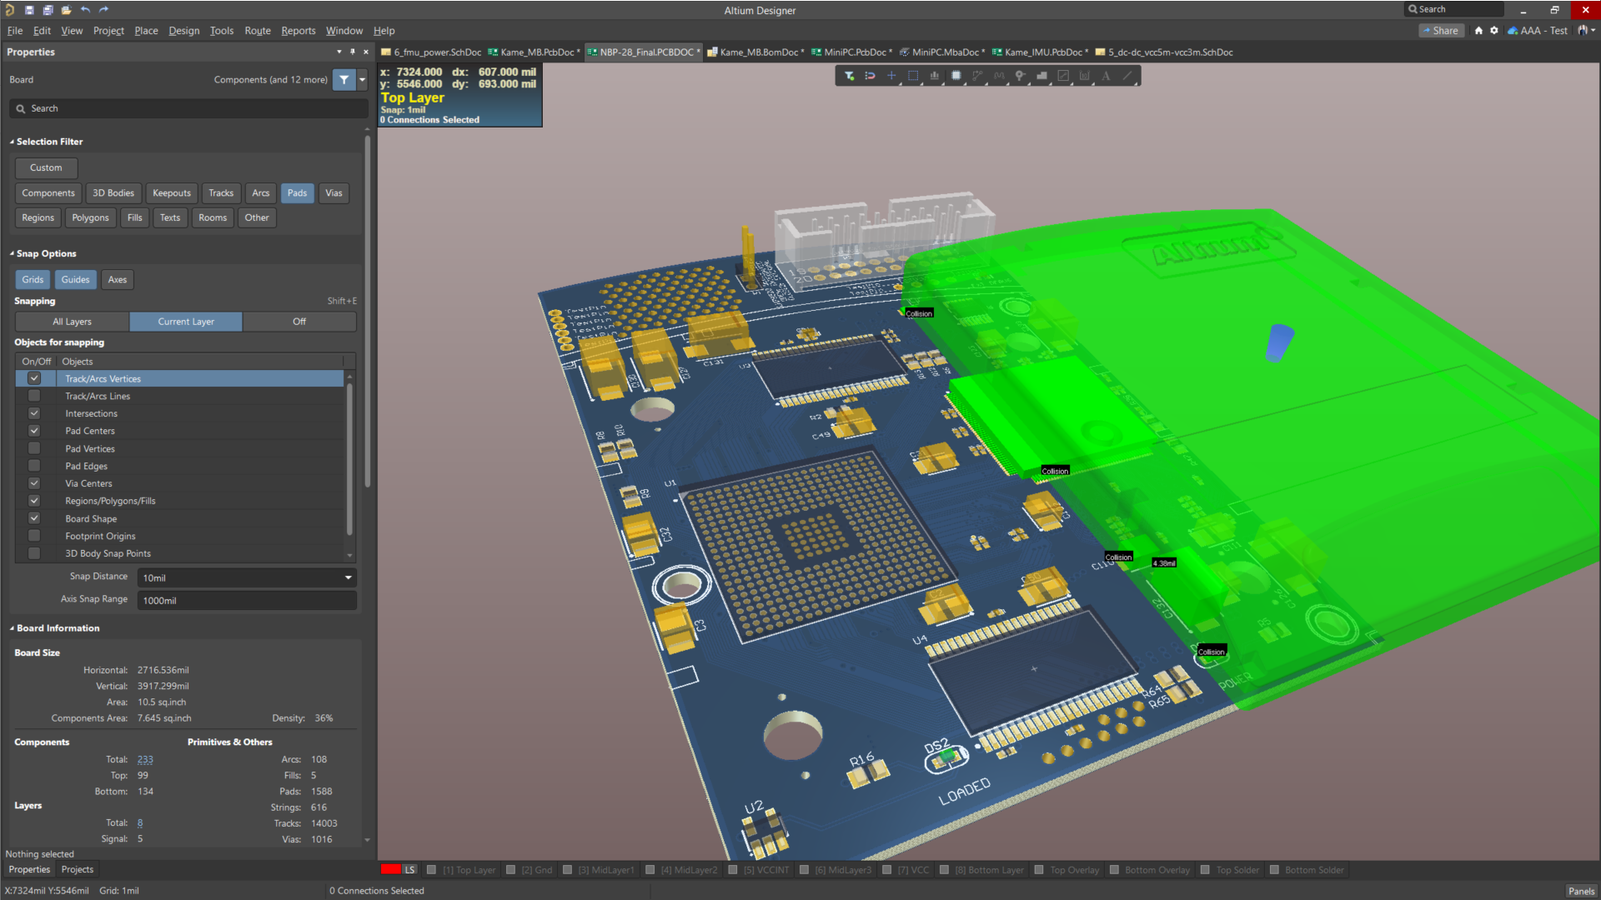
Printed Circuit Board (PCB)
A more permanent solution: Printed Circuit Boards (PCBs)
→Flat board made of insulating material (usually fiberglass epoxy resin, FR-4) with thin layers of conductive copper traces patterned on it to act as “wires” between components.
Electronic Design Automation (EDA)
PCB design software (analogous to CAD for mechanical parts)
Facilitates design of schematic & physical PCB
Common software:
Altium
KiCAD
Eagle / Fusion 360

Slide 22
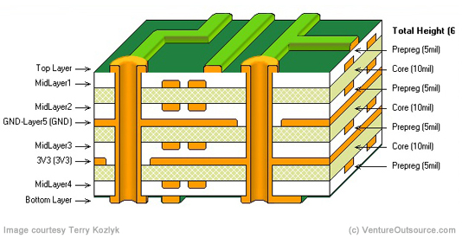
PCB Stackup
The cross-sectional layout of copper and dielectric layers that define how signals, power, and ground are routed within a circuit board.
Example 8-Layer PCB Cross Section
Copper traces
“Via” used to connect copper on different layers

Slide 23
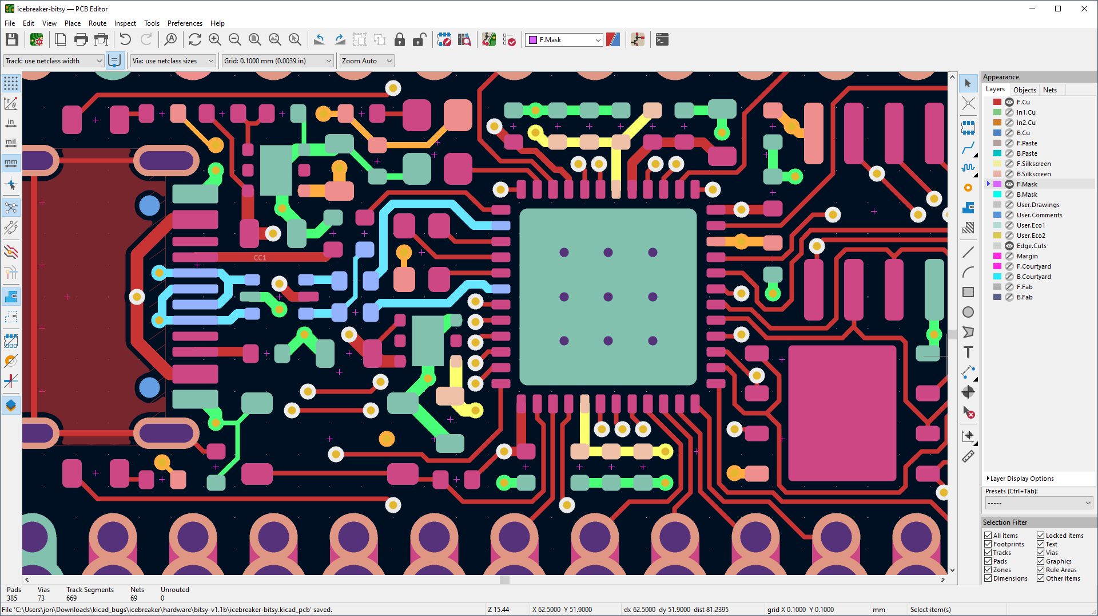
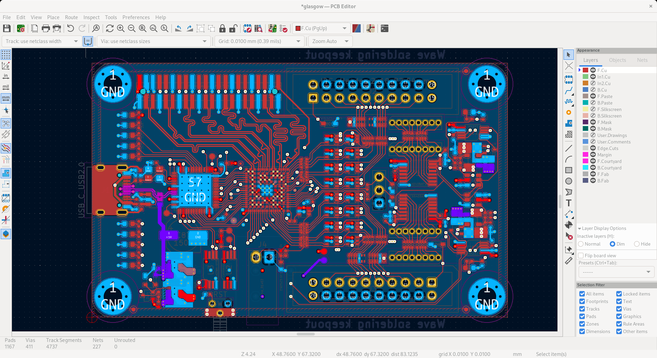
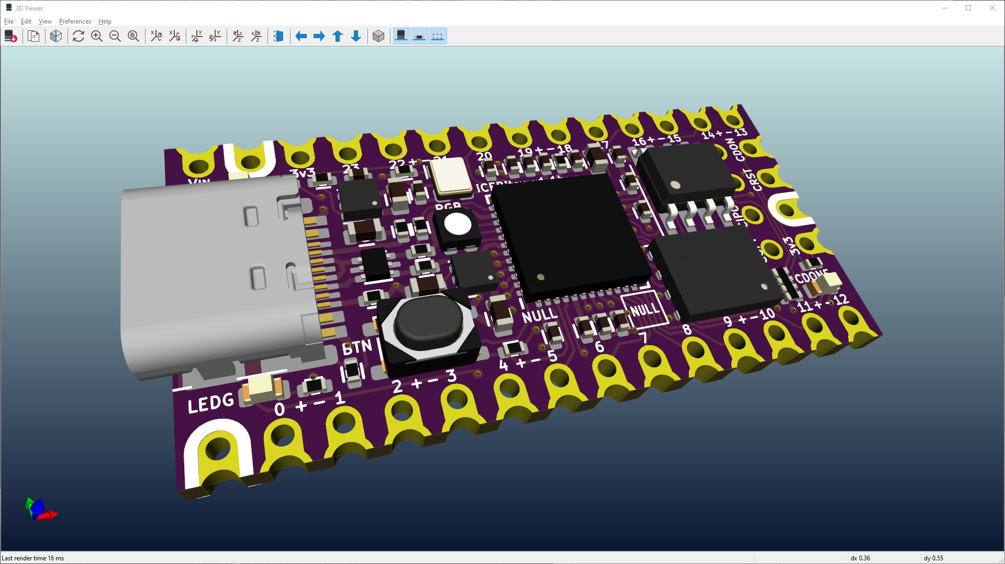
PCB Layout and Routing
PCB Layout is the process of translating the schematic design int a physical board design.
→The “floor plan” of the circuit.
Routing is the process of drawing the copper traces (wires) that connect components according to the schematic.

Slide 24
Intro to Embedded Programming with Arduino

Slide 25
Topics
What is
Arduino?
An IDE?
A ‘sketch’?
Basic structure of a sketch?
Arduino syntax?
Type declarations
Semi-colons..
Case-sensitive
Relation to C++ ?
Variable types?
Object-oriented programming…?

Slide 26
Arduino Variable Types Reference
Type | Alternate / stdint | Size | Range | Notes
byte | uint8_t | 1 byte | 0 to 255 | Unsigned 8-bit
char | int8_t | 1 byte | -128 to 127 | Single character
unsigned char | uint8_t | 1 byte | 0 to 255 | Raw bytes
short | int16_t | 2 bytes | -32,768 to 32,767 | Rarely used
unsigned short | uint16_t | 2 bytes | 0 to 65,535 | Positive 16-bit integer
int | int32_t | 4 bytes | -2,147,483,648 to 2,147,483,647 | Default integer on Pico
unsigned int | uint32_t | 4 bytes | 0 to 4,294,967,295 | Positive 32-bit integer
long | int32_t | 4 bytes | -2,147,483,648 to 2,147,483,647 | 32-bit integer
unsigned long | uint32_t | 4 bytes | 0 to 4,294,967,295 | Positive 32-bit integer
float | float | 4 bytes | ±3.4E38, ~6–7 digits | Single-precision decimal
double | double | 8 bytes | ±1.7E308, ~15–16 digits | Double-precision decimal
bool | bool | 1 byte | true/false | Logical value
String | String | varies | N/A | Arduino text string class
const | const | N/A | N/A | Immutable variable
volatile | volatile | N/A | N/A | Used in interrupts/hardware
enum | enum | 4 bytes (default) | Depends on values | Named integer constants
struct | struct | N/A | N/A | Composite type for grouping variables

Slide 27
EXTRA MATERIAL (not testable)

Slide 28
Digital Logic Reference

Slide 29

Boolean Logic
3 Primary Operators
AND, OR, NOT
# of outcomes depends on number of inputs
$$outcomes=2^{\# of inputs}$$
Two states for a Binary Signal
TRUE | FALSE
On | Off
1 | 0
5 volts (or less in modern circuits) | 0 volts

Slide 30

Digital Logic Gates
The “AND” Gate
If both inputs are true, then output true
A | B | Output (Q)
0
0
0
0
1
0
1
0
0
1
1
1
Wiring Symbol:
Math Symbol:
Boolean Equation:
A
Q
* x ∙ ()
A ∙ B = Q
B

Slide 31
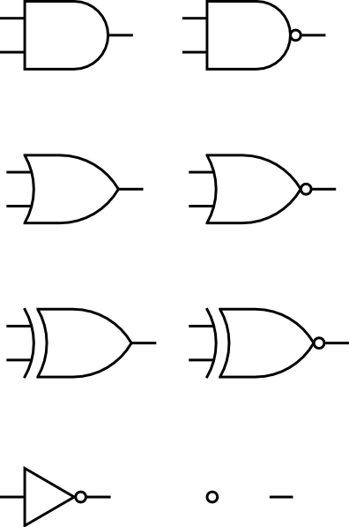
Digital Logic Gates
The “OR” Gate
If either input is true, then output true
A | B | Output (Q)
0
0
0
0
1
1
1
0
1
1
1
1
Wiring Symbol:
Math Symbol:
Boolean Equation:
A
Q
+
A + B = Q
B

Slide 32

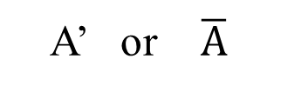
Digital Logic Gates
The “NOT” Gate
Output is opposite of the input
A | Output (Q)
0
1
1
0
Wiring Symbol:
Math Symbol:
Boolean Equation:
A
A’
A’ or $\overline{A}$
A’ = Q

Slide 33
Boolean Algebra
Identity Element
a+0=a
a+1=1
a*0=0
a*1=a
Involution
(a')'=a
Complementation
a+a'=1
a*a'=0
Idempotency
a+a=a
a*a=a
Associative (grouping doesn't matter)
a+(b+c)=(a+b)+c
a*(b*c)=(a*b)*c
Commutative (order doesn't matter)
a+b=b+a
a*b=b*a
Distributive for BOOLEAN ALGEBRA
a+(b*c)=(a+b)*(a+c)
a*(b+c)=(a*b)+(a*c)
Absorption
a+a*b=a
Adjacency
a*b+a*b'=a

